Slide 1
secure data hiding images using stenography
Presented By: PALA RAMYAKRISHNA
Student Name : PALA RAMYAKRISHNA
College Name & Department : GUDLAVALLERU ENGINEERING COLLEGE,INFORMATION TECHNOLOGY.

Slide 2
OUTLINE
Problem Statement
Technology used
Wow factor
End users
Result
Conclusion
Git-hub Link
Future scope

Slide 3
Problem Statement
With increasing digital communication, securing sensitive data is crucial. While encryption protects data privacy, it doesn't hide the existence of the data itself. Image-based steganography offers a solution by embedding secret data in images, making it less detectable. However, challenges remain in:
Detectability: Preventing unauthorized detection of hidden data.
Data Integrity: Ensuring the data remains intact despite image modifications.
Embedding Capacity: Maximizing the amount of hidden data without affecting image quality.
Security: Protecting hidden data through encryption and error correction.
This project aims to develop a secure and efficient method for hiding data in images, addressing these challenges to ensure data remains confidential and undetectable.

Slide 4
Technology used
OpenCV (cv2): Primarily used for image processing and computer vision.
os module: Used for file and system management (such as checking files and handling paths).
string module: Used for string manipulation and utility functions (e.g., converting text to binary).
Python: It is a versatile, high-level programming language that's widely used for tasks ranging from web development to data science, and particularly image processing and cryptography. Its simplicity and the vast collection of libraries make it ideal for creating a steganography solution.

Slide 5
Wow factors
1. Enhanced Security Through Concealment
Invisible Protection: This adds an extra layer of security because the data isn’t visible or detectable, even if intercepted
Multi-layered Security:. In this project, you can combine steganography with encryption, so that even if the hidden data is discovered, it remains protected by an encryption algorithm.
2. Real-World Application in Privacy Protection
Digital Privacy:. By embedding secret data in images (which are common and largely ignored), the hidden information becomes almost impossible to detect or extract without prior knowledge.
Uses Encryption-based Steganography AES.
3. Challenge of High Capacity and Low Detectability: challenge of increasing the capacity of hidden data (the amount you can hide) while minimizing the detectability which uses Least Significant Bit (LSB) Algorithm

Slide 6
End users
The end users of a Secure Data Hiding in Images Using Steganography system can vary across different fields and industries, depending on the application and the need for secure, covert communication. Below are some potential end users who would benefit from such a system:
Government and Military Organizations
Intelligence and Law Enforcement Agencies
Journalists and Activists
Corporate Entities and Businesses
Digital Artists and Creators
Cybersecurity Professionals
Researchers and Academia
Cryptocurrency Users (Blockchain & Cryptocurrency Transactions)

Slide 7
Results
INPUT:

Slide 8
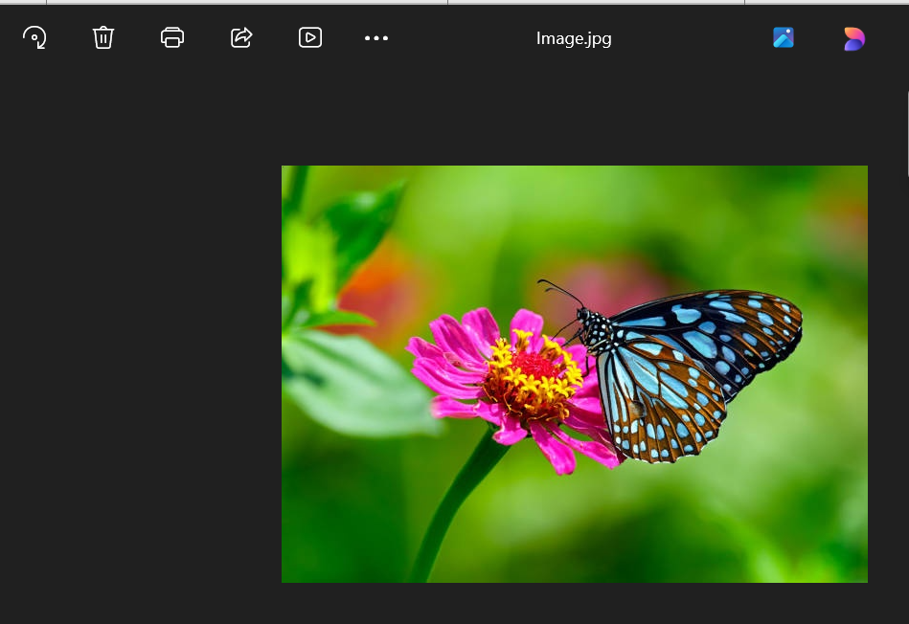
Results
OUTPUT:

Slide 9

Results
OUTPUT:

Slide 10
Conclusion
The Secure Data Hiding in Images Using Steganography project provides an effective method for embedding sensitive information into digital images without detection. It combines steganography and cryptography to ensure that hidden data remains secure and invisible, even if intercepted. This approach enhances privacy, confidentiality, and security in digital communication across various fields like government, business, and personal use.
The project demonstrates the practical application of steganography for covert communication, with future potential for integration with AI, blockchain, and IoT to improve security further. Overall, the project underscores the importance of protecting digital data in an increasingly connected world, offering a robust solution for secure, private information transfer.

Slide 11
GitHub Link
https://github.com/ramyakrishnapala/ibm-cybersecurity-stenography.git

Slide 12
Future scope(optional)
The future scope of Secure Data Hiding in Images Using Steganography is promising, with potential for significant advancements and new applications. As technology evolves, steganography will continue to play a crucial role in various fields, especially in data security and privacy protection. Below are some key areas where the future of this project could expand:
Integration with Advanced Cryptographic Techniques
Use of Artificial Intelligence (AI) and Machine Learning (ML)
Video Steganography and Real-time Communication
Integration with Blockchain Technology
Steganography in Internet of Things (IoT) Devices
Cross-Media Steganography
Privacy and Data Protection in Cloud Storage
Social Media and Digital Communication Platforms

Slide 13
THANK YOU

